Slide 1

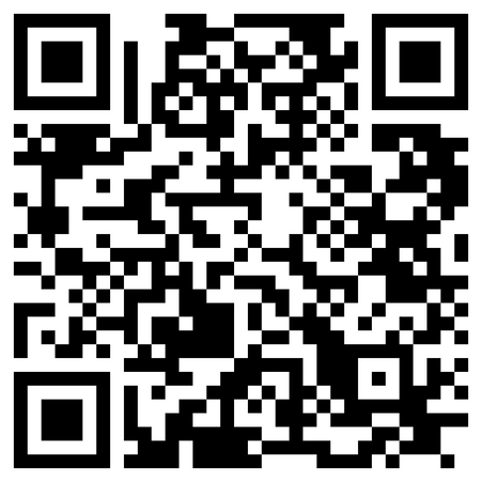

Wonder
Thank you for your generous support of the Easter Special Offering!
The Easter Special Offering assists General Ministries, including the NBA. Your gift fuels our mission to advocate for the well-being of humanity, empowering leaders and supporting innovative organizations. With the support of community, we know that wholeness, wellness, and a bold vision for a liberated world are possible.
For more information about the Easter Special Offering, visit https://disciplesmissionfund.org/special-offerings/EASTER
or scan the QR code.

